Slide 1

What's New in ASP.NET Core?
Presents
Pandiyan Murugan
Notes:
1

Slide 2
ASP.NET Core 2.2
Preview 2

Slide 3
Getting started with ASP.NET Core 2.2 Preview 2
Install the .NET Core 2.2 Preview 2 SDK
https://www.microsoft.com/net/download/dotnet-core/2.2
Install Visual Studio 15.9 Preview 2
https://visualstudio.microsoft.com/vs/preview/
Notes:
3

Slide 4
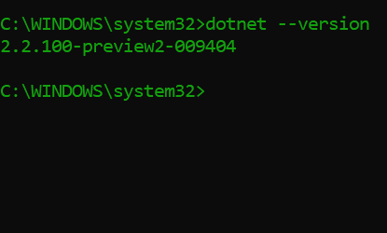
Verify the version

Slide 5
Features
Notes:
5

Slide 6
ASP.NET Core 2.2 features
Template updates: Bootstrap 4, Angular 6
Web API improvements
HTTP/2
IIS in-process hosting
Health checks
Endpoint routing
SignalR Java client
Notes:
Template updates: Scaffolder, Templates & Default UI
Web API Improvements: Big theme for this release. API development easier & better
Support for HTTP/2
IIS in-process hosting for much better performance & reliability
Health checks framework – confirm live and ready for traffic

Slide 7
Template updates
Notes:
Show demo for minified scaffolding and template updates

Slide 8
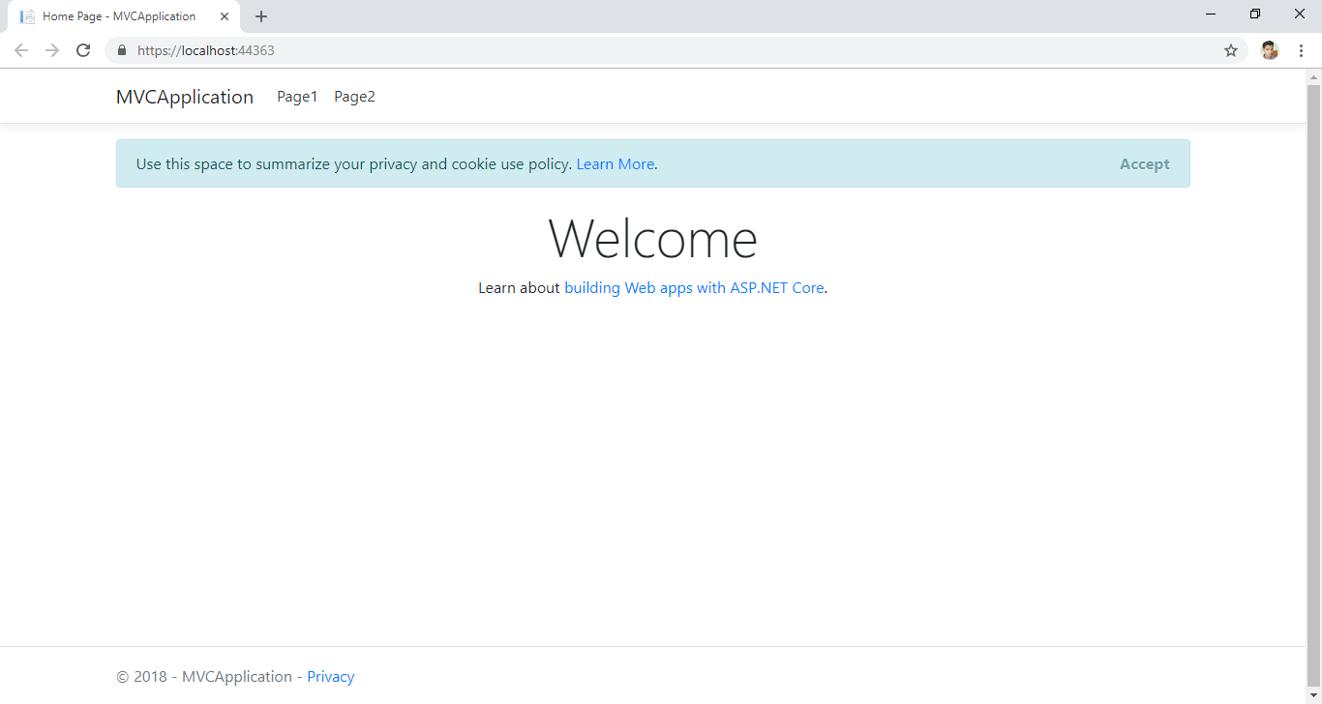
Notes:
Added default placeholder for cookies accept message
Cleaner scaffolding files
Less content to delete if we want to get started with a new project

Slide 9
Web API Improvements in ASP.NET Core 2.2
Easier to create
Easier to test & debug
Easier to document
Easier to consume
Easier to secure
Easier to monitor
Improved performance

Slide 10
Web API Improvements
Notes:
10

Slide 11
HTTP/2
Now available cross-platform in Kestrel
Application-Layer Protocol Negotiation (ALPN)
Header compression
Multiplexed stream over same connection
Some limitations
Server push, stream prioritization not currently supported
Not supported for edge use at this time
Notes:
HTTP/2 is a major revision of the HTTP protocol. Some of the notable features of HTTP/2 are support for header compression and fully multiplexed streams over the same connection.
While HTTP/2 preserves HTTP’s semantics (HTTP headers, methods, etc) it is a breaking change from HTTP/1.x on how this data is framed and sent over the wire.

Slide 12
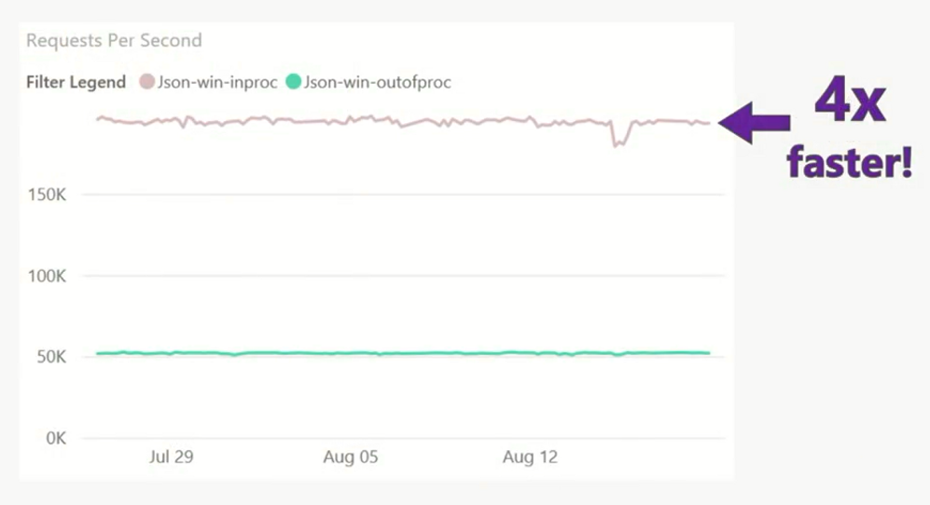
IIS in-process hosting
Out of process
In Process
Improved performance, reliability and diagnostics

Slide 13
IIS in-process hosting

Slide 14
Health checks
Add dedicated health endpoints to your application
Integrate with container orchestrations and load balancers
Support liveness and readiness

Slide 15
Endpoint routing
New routing implementation (default for 2.2)
Better throughput and scalability
Link to endpoints from outside of MVC

Slide 16
SignalR Java Client
Connect to ASP.NET Core SignalR hubs in Java
Available via Gradle and Maven
Now supports Azure SignalR Service

Slide 17
efficientuser.com twitter.com/efficientuser

